Slide 1

Department of Information Technology
NBA Accredited A.P. Shah Institute of Technology G.B.Road,Kasarvadavli, Thane(W), Mumbai-400615 UNIVERSITY OF MUMBAI Academic Year 2021-2022

Slide 2
A Project Report on
Credit Card fraud Detection
Submitted in partial fulfilment of the degree of Bachelor of Engineering(Sem-8) in INFORMATION TECHNOLOGY By Sakshi Ravindra Shinde(19104055) Divya Sanjiv Shepal (19104053) Shubhangi Babaji Lanke (19104064) Under the Guidance of Name of Guide : Prof. Manjusha Kashilkar

Slide 3
1.Project Conception and Initiation

Slide 4
1.1 Objectives
To Identify Fraudulent Credit card transaction
To detect 100% of the Fraudulent transactions while minimizing the incorrect fraud classifications.
To estimate, perceive or avoid objectionable behaviour , which consist of fraud , intrusion and defaulting .

Slide 5
1.2 Literature Review
Fabiana Fournier, Ivo carriea, Inna skarbovsky, The Uncertain Case of Credit Card Fraud Detection, The 9th ACM International Conference On Distributed Event Based Systems(DEBS15) 2015
A Comparative Analysis of Various Credit Card Fraud Detection Techniques:
Iwasokun GB, Omomule TG, Akinyede RO. Encryption and tokenization-based system for credit card information security. Int J Cyber Sec Digital Forensics. 2018;7(3):283–93.

Slide 6
1.3 Problem Definition
Unauthorized transactions and unwanted usage of an account by someone other than the owner of the account.
Massive stream of payment requests were generated on daily basis.

Slide 7
1.4 Scope
Can be applied in banking organizations.
Can be used to decrease the fraud attempts.
Can be used to enhance the process and guarantee the security of the account.

Slide 8
1.5 Technology stack
VS Code
lightweight that provides the freedom to customize.

Slide 9
2. Project Design

Slide 10
2.1 Proposed System
To help us classify fraudulent and legitimate credit card transaction by supervised learning Algorithm such as Random forest.
To help us to get awareness about the fraudulent and without loss of any financially.

Slide 11
2.2 Design(Flow Of Modules)
Importing Dataset
Conversion of data into frames format
Data Sampling
Data Separation For Training and Testing
Assigning train datasets to the models
Applying algorithm and Creating the model
Making Predictions for test dataset
Calculating Accuracy

Slide 12
3. Implementation

Slide 13
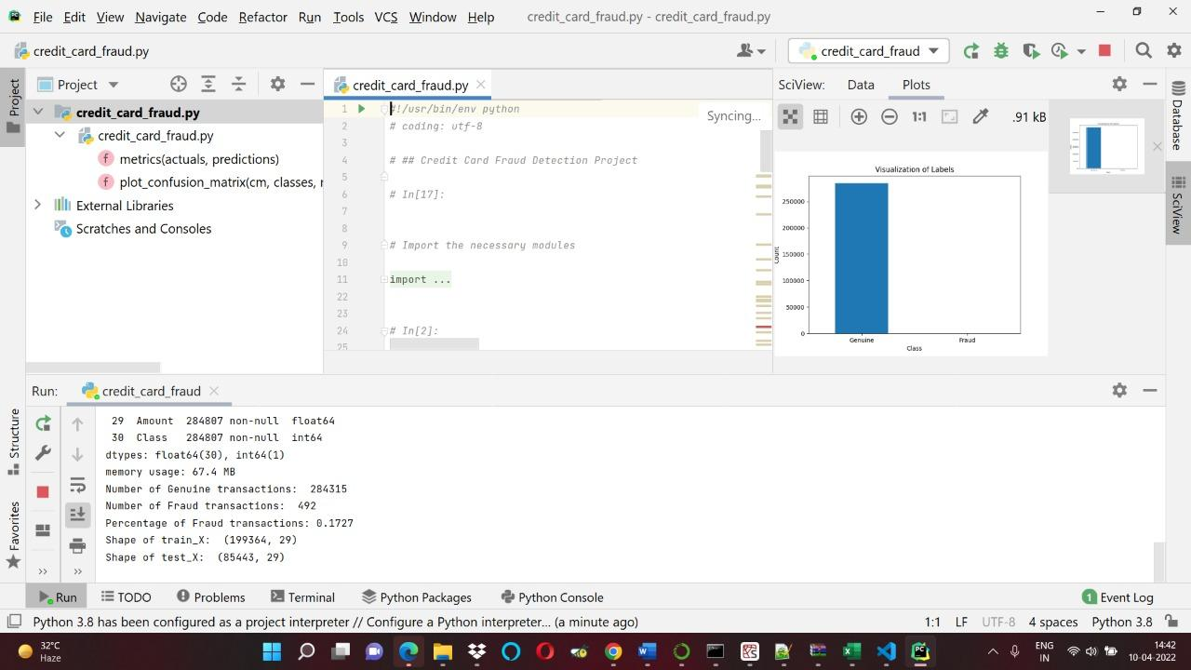

Slide 14
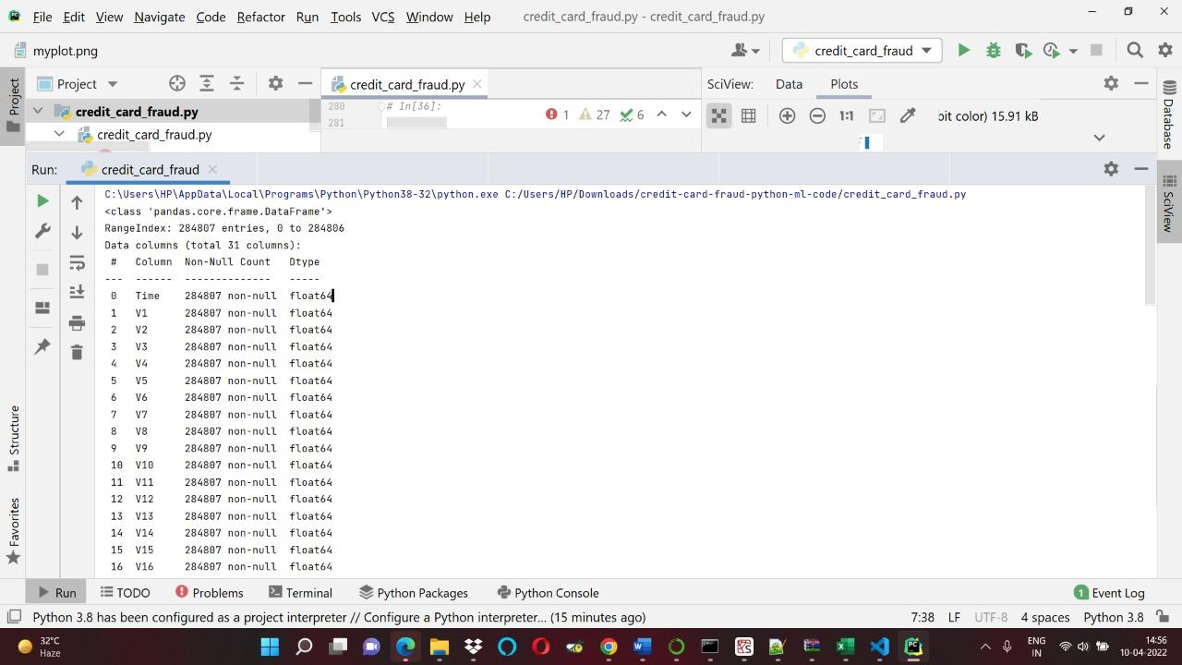

Slide 15
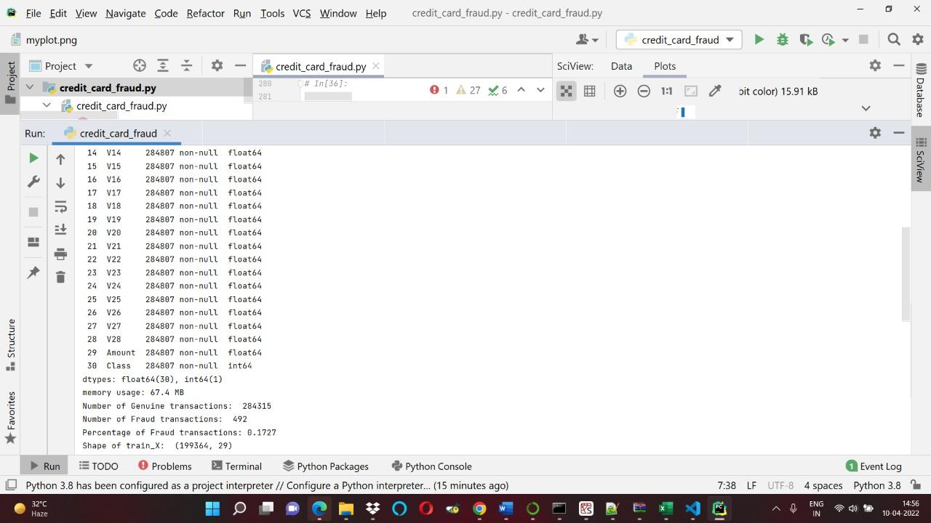

Slide 16
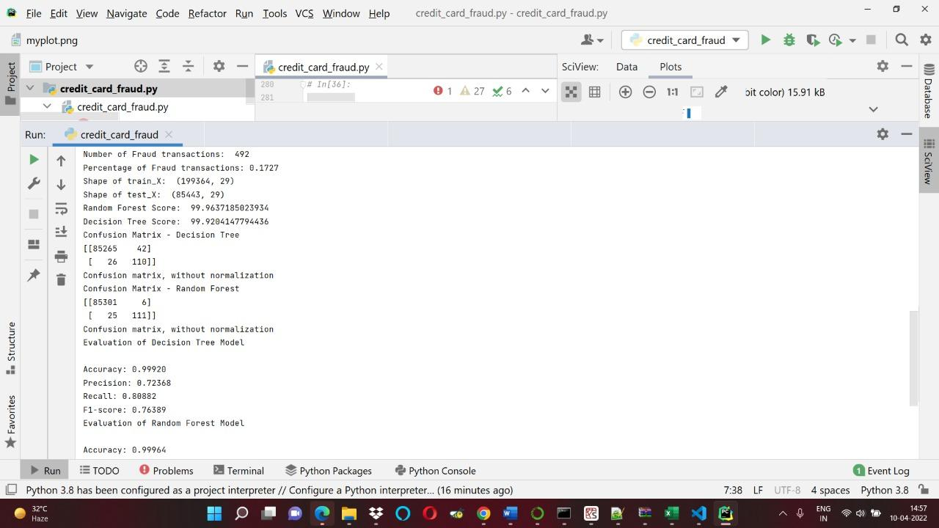

Slide 17
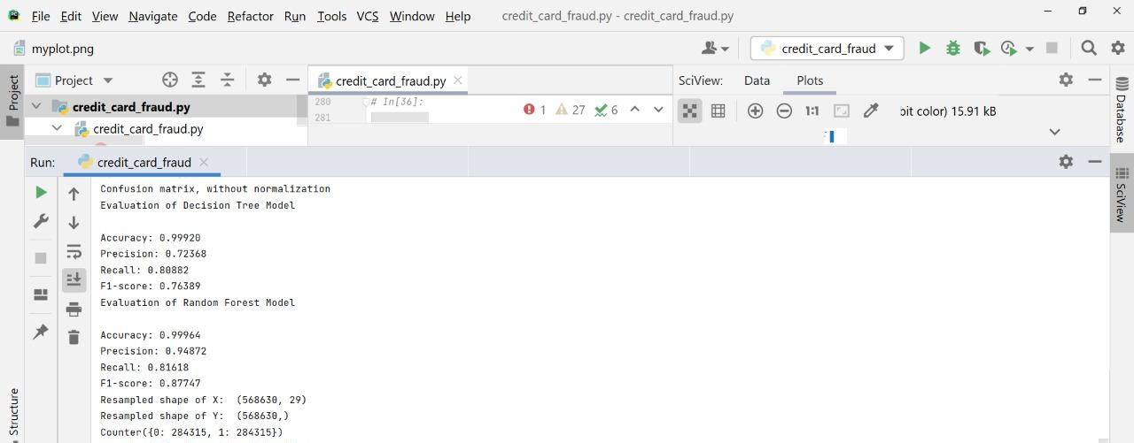

Slide 18
5. Result

Slide 19
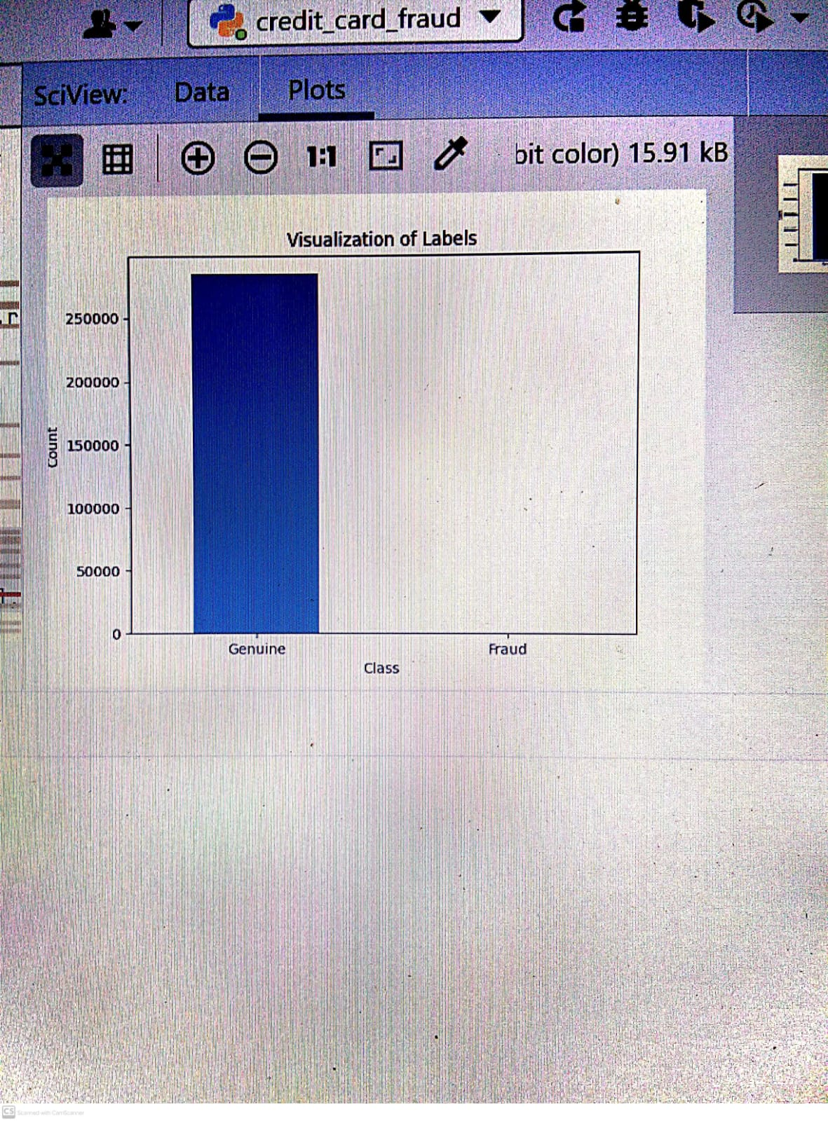

Slide 20
6. Conclusion and Future Scope

Slide 21
A series of anti-fraud strategies can be adopted to prevent banks from great losses and reduce risks.
This approach is ineffective in the long run as they are too broad to find ever more sophisticated forms of fraud.
Due to the sensitive nature of the topic, often datasets are not available to effectively evaluate existing methods of fraud detection
We cannot determine the names of fraud and genuine transactions for the given dataset using machine learning.

Slide 22
References
https://data-flair.training/blogs/credit-card-fraud-detection-python-machine-learning/amp/
https://www.kaggle.com/code/fernolf/credit-card-fraud-detection/notebook
http://sdiwc.net/digital-library/encryption-and-tokenizationbased-system-for-credit-card-information-security.html

Slide 23
Thank You

